Slide 1
College Application
Team Members: 1. Vidhya
2. Pratyusha
3. Preethi
4. Raju

Slide 2
Existing System
The Existing system involves working manually, which takes lot of time i.e if user wants to apply for the course he needs to come to college and has to fill the form manually and also administrator has to maintain the records of the applicants. Which results in loss of time and performance issues.

Slide 3
Proposed System
So, Keeping everything on mind we are designing a web based application which makes the work more simplified and automated.
For Ex- If a new user what's to take admission in the college he/she can refer the website and apply for a admission online. And the data entered by the user will be directly stored in the data base.

Slide 4
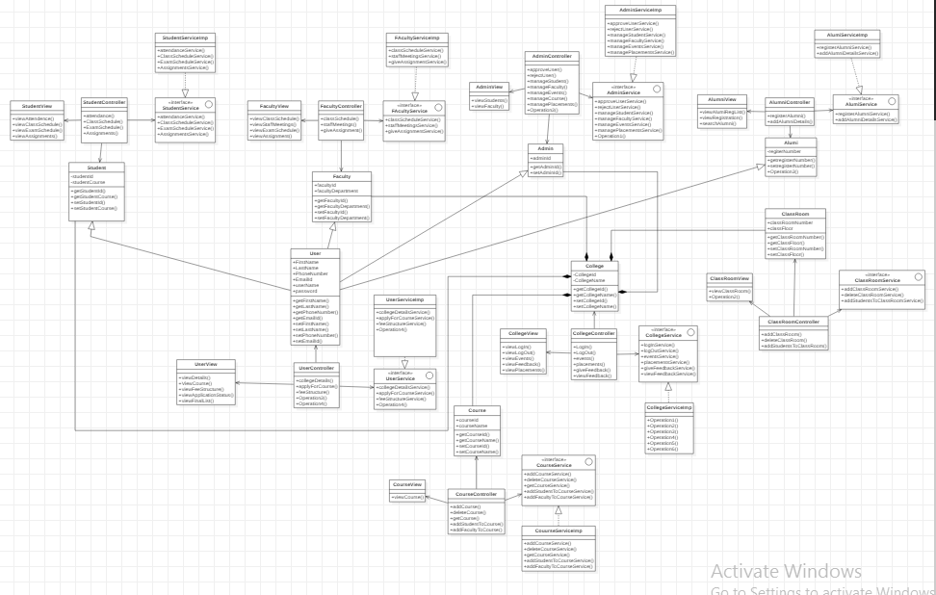
Class Diagram

Slide 5
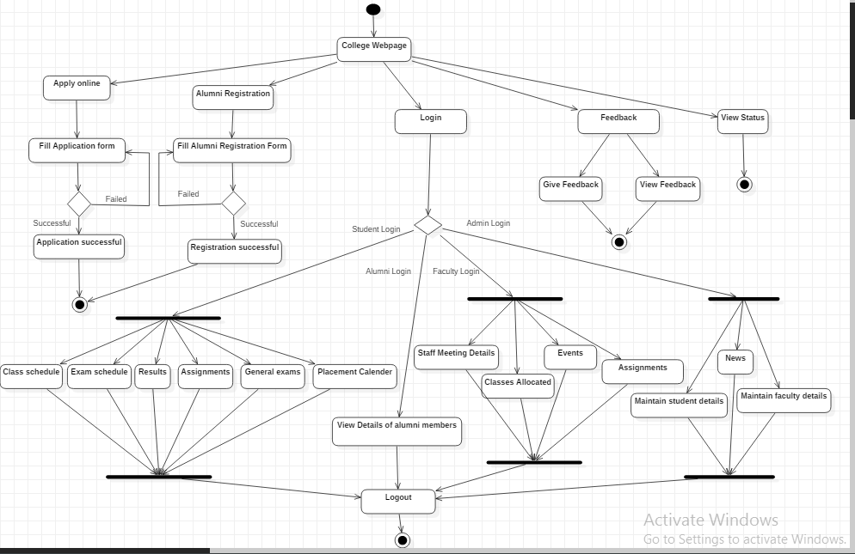
Activity Diagram

Slide 6
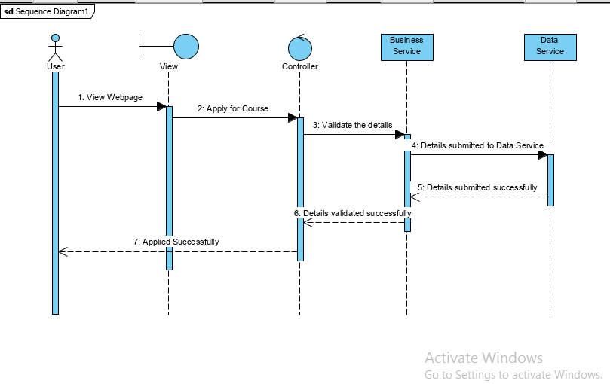
Sequence Diagram

Slide 7
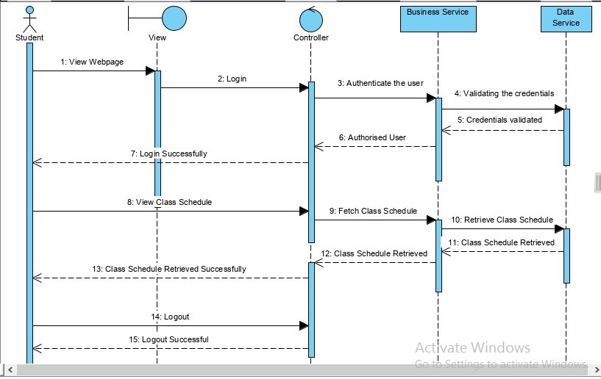
Sequence Diagram

Slide 8
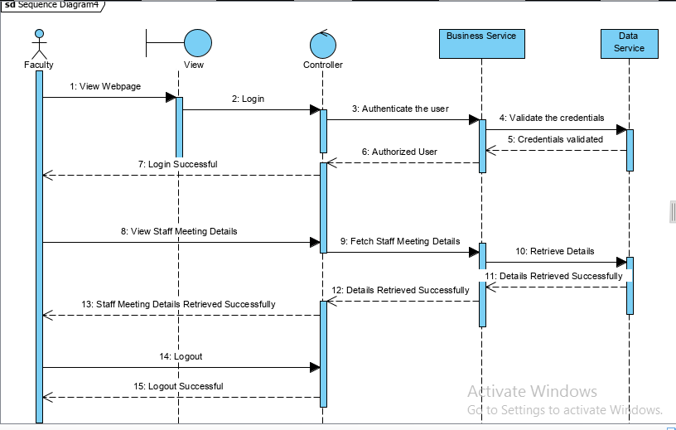
Sequence Diagram

Slide 9
Sequence Diagram

Slide 10
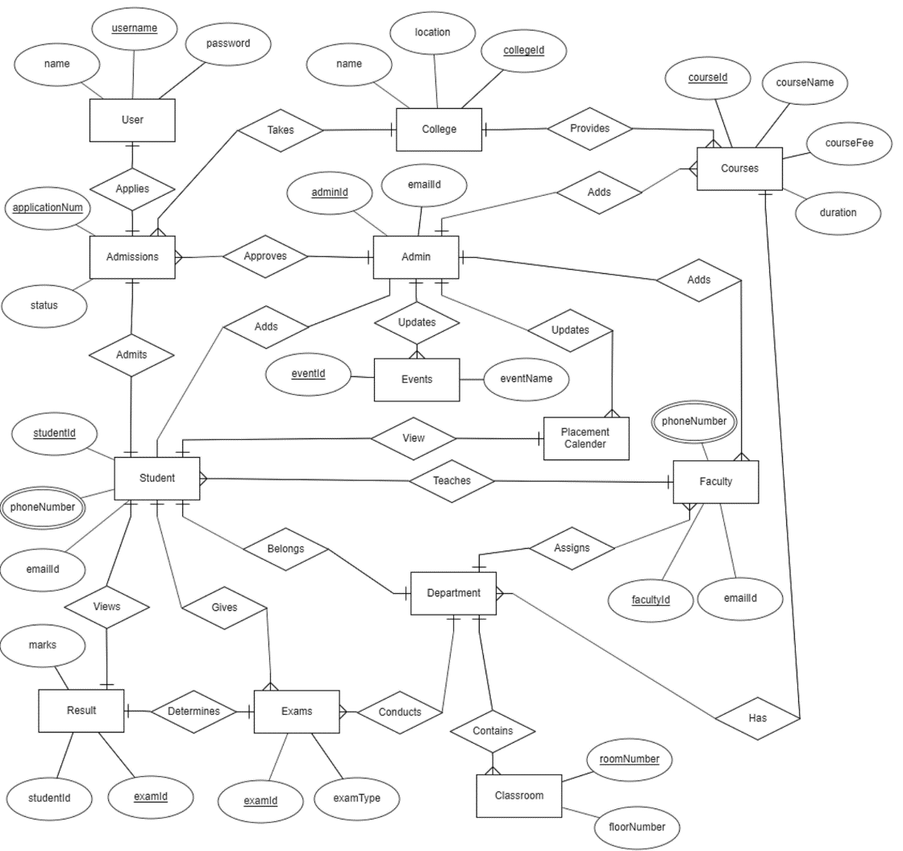
ER Diagram

